Slide 1
Introduction to Neo4j Graph Database
Derrick Fei Wang

Slide 2
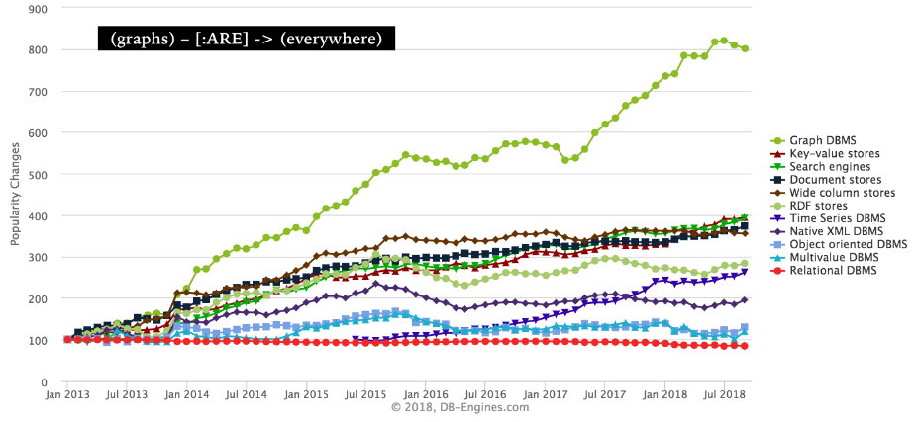
Notes:
https://www.kdnuggets.com/2018/10/graphs-next-frontier-data-science.html

Slide 3
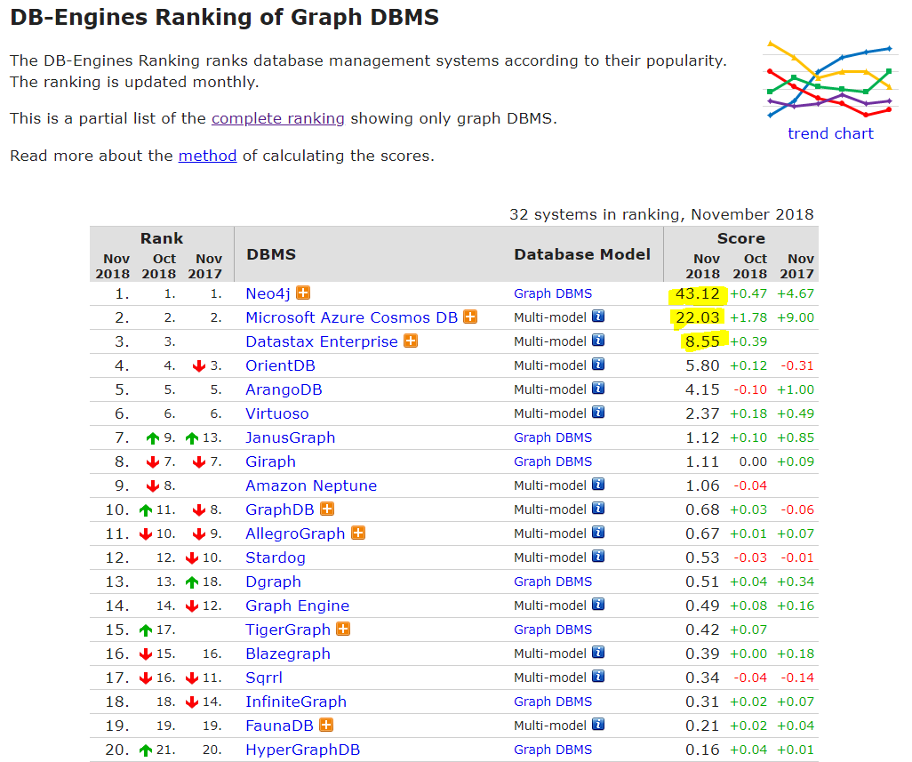
https://db-engines.com/en/ranking/graph+dbms
Notes:
https://db-engines.com/en/ranking/graph+dbms

Slide 4
Agenda:
What is Graph Database
Why use Graph Database
Brief introduction about Neo4j and Cypher
Use case: Data flow and object dependency analysis
How to Create a graph database in Neo4j
How to query Neo4j database

Slide 5
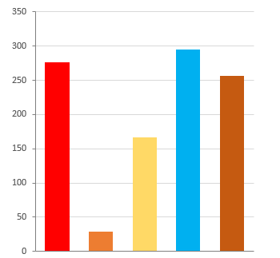
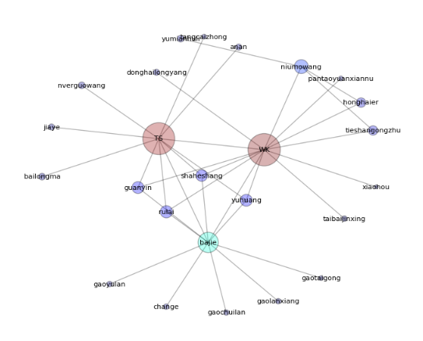
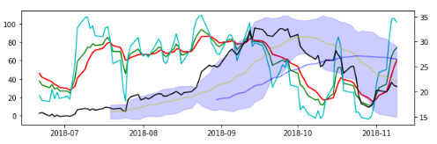
Graph

Slide 6
1. What is Graph Database
Person
Name: “Bob”
Age: 27
Loves
Person
Name: “Jane”
Age: 25
Loves
Live With
Drives
Owns
Car
Made: Ford
Year: 2017

Slide 7
Nodes:
Person
Person
Car

Slide 8
Edges: Relationships
Person
Loves
Person
Loves
Live With
Drives
Owns
Car

Slide 9
Properties:
Person
Name: “Bob”
Age: 27
Loves
Person
Name: “Jane”
Age: 25
Loves
Live With
Drives
Owns
Car
Made: Ford
Year: 2017

Slide 10
Summary
Graph database store data in:
Nodes
Edges
Properties
Labels

Slide 11
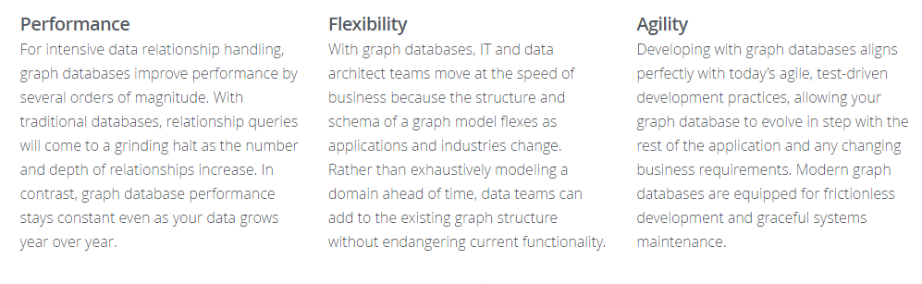
2. Why use graph database

Slide 12
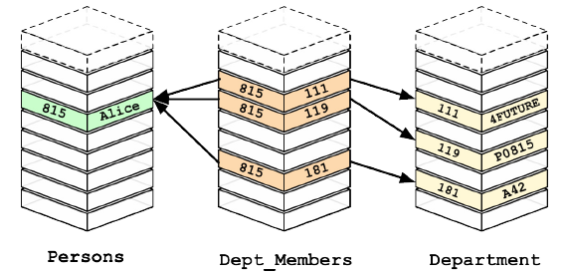
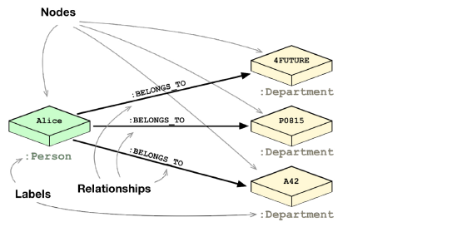
2. Why use graph database
Fast

Slide 13
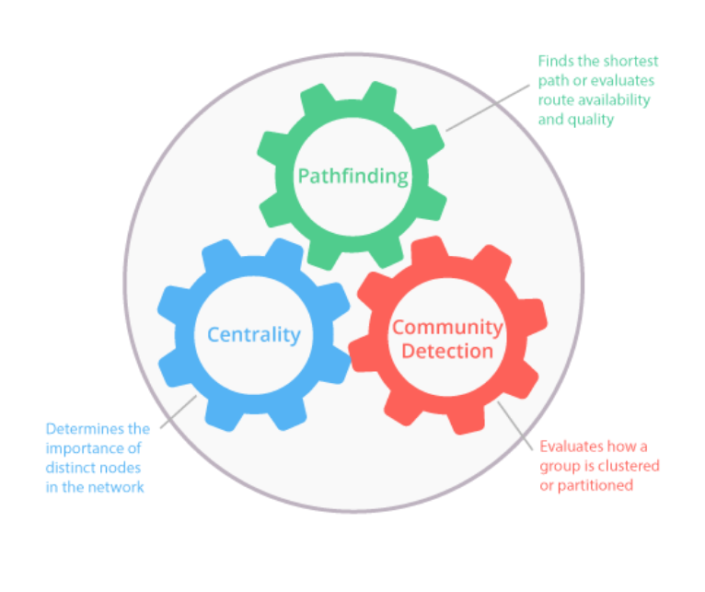

Slide 14
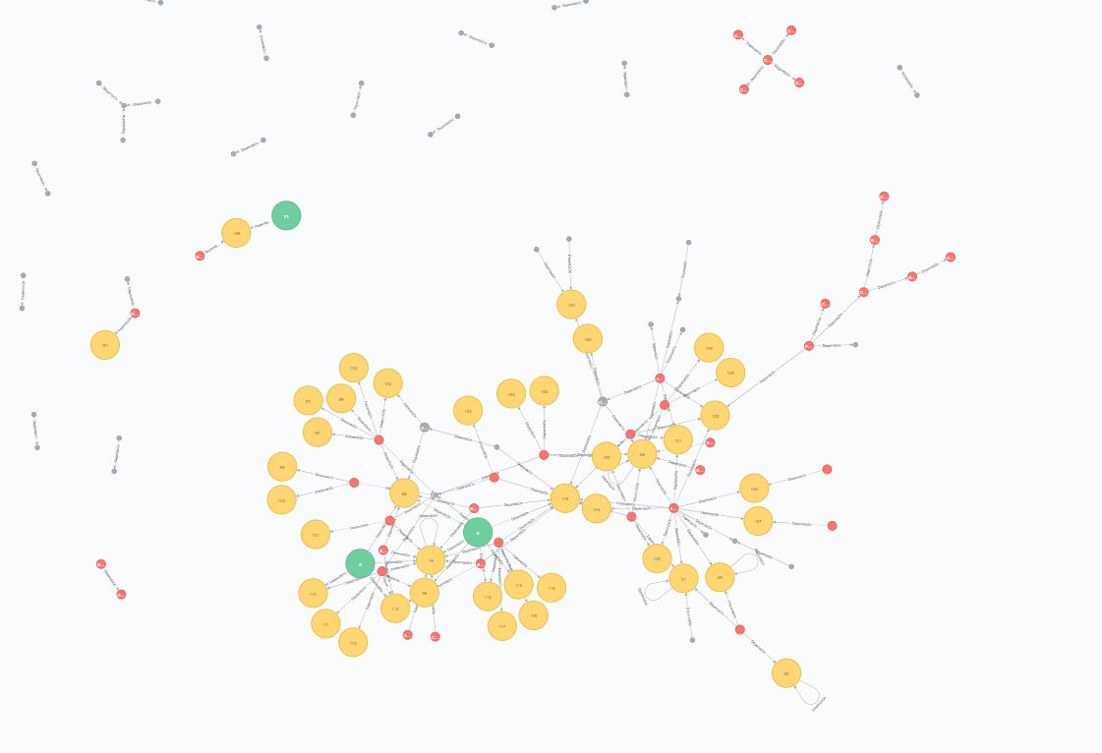
Human brain process and memorizes picture better than text
A picture is worth a thousand words
Provide new way of thinking and new solution for tasks

Slide 15
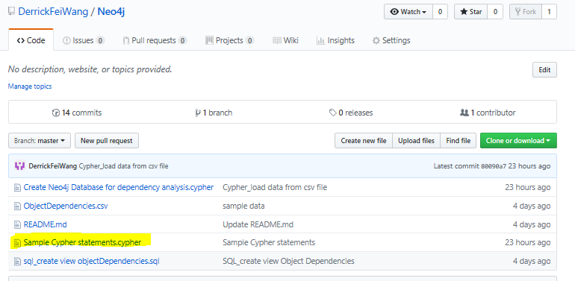
3. Neo4j and Cypher
See basic cypher statements in the “Sample Cypher statements.cypher” file

Slide 16
Example Use Case: Object Dependencies in a Relational Database
Challenges:
You need to use data from a unfamiliar database that has hundreds of objects (tables, views, proc, function, etc)
A shared database used by different developers/teams
Data flow review
Solutions：
Step 1: Query the database information schema, save object dependency information into a csv file.
Step 2: Import the data from csv file into Neo4j, create a graph database.
Step 3: Use Cypher to query Neo4j graph database to view the relationship

Slide 17
Sample SQL Server Database
This sample database is used for extracting its metadata for object dependencies analysis
Database: WideWorldImporter (WWI)
A sample SQL Server database provided by Microsoft
Download and Install:
https://blog.sqlauthority.com/2016/06/17/sql-server-2016-import-new-sample-database-wideworldimporters/

Slide 18

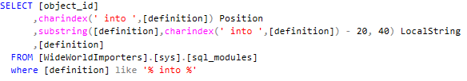
Limitation:
SQL Server sys.sql_expression_dependencies view
Can’t capture the relationship in statements like this:
Solution:
sys.sql_modules

Slide 19
Graph Algorithm
Social network analysis:
Community Analysis
Betweenness Centrality
Page Rank

Slide 20
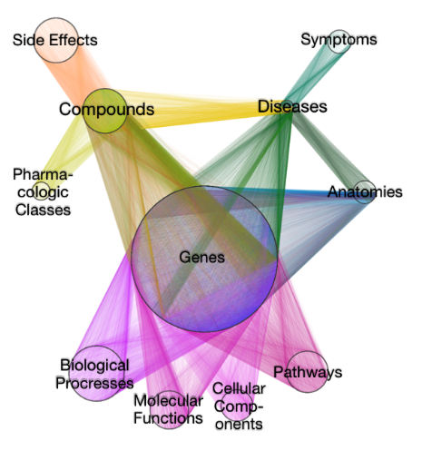
Daniel Himmelstein:
https://github.com/dhimmel/hetionet
https://neo4j.het.io/browser/

